Slide 1
Installation Guide Martin Alvarez Cyber Security Consultant Intern

Slide 2
The following is an installation guide for NodeJS and the tools that we will be providing for Security Verify
For reference, we will be installing it on a Red Hat 8.4 server
Notes:
Refer back often to download the latest IBM Security Template: https://security-design-guide.stage1.mybluemix.net/brand/essentials/marketing-assets/#

Slide 3
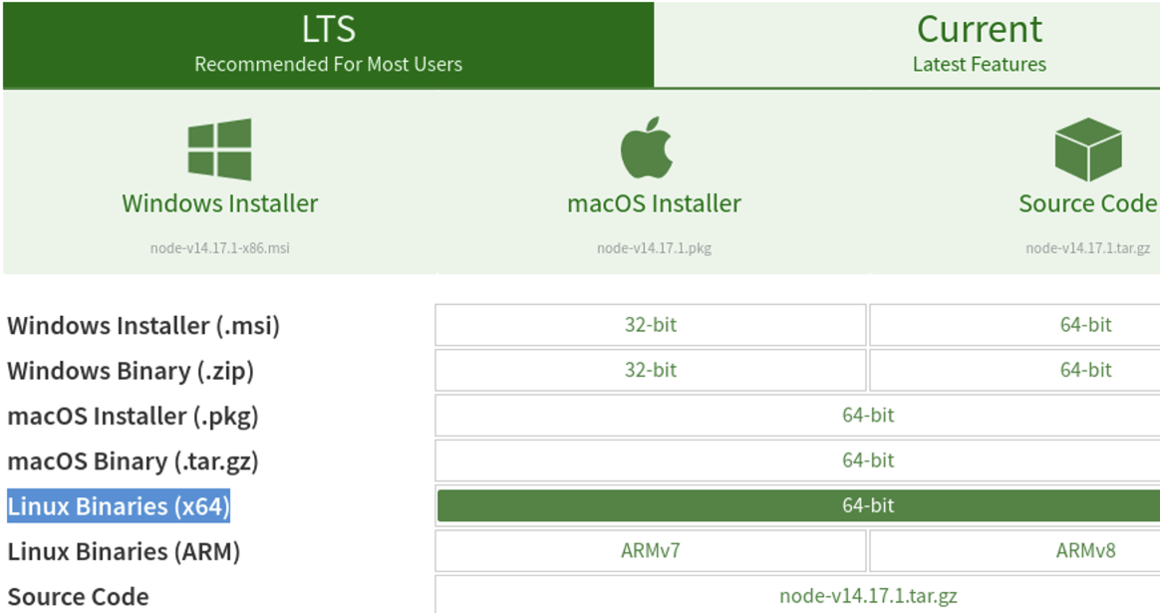
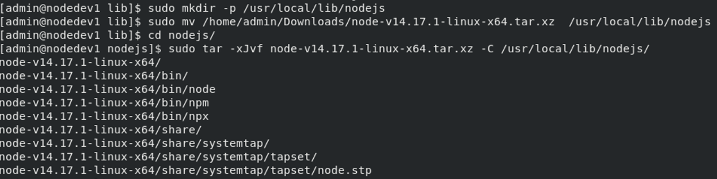
Ensure that you are logged in with administrative privileges
https://nodejs.org/en/download/ navigate here to download and save the version that corresponds to your OS
Run the following commands:
sudo mkdir –p /usr/local/lib/nodejs
mv (locationOfSourceFile) /usr/local/lib/nodejs
sudo tar –xJvf node-(version)-(distro).tar.xz –C /usr/local/lib/nodejs
Notes:
Refer back often to download the latest IBM Security Template: https://security-design-guide.stage1.mybluemix.net/brand/essentials/marketing-assets/#

Slide 4
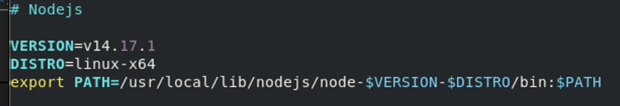
Open in your editor of choice ~/.profile and add the following to the end:
# Nodejs
VERSION=14.17.1
DISTRO=linux-x64
export PATH=/usr/local/lib/nodejs/node-$VERSION-$DISTRO/bin:$PATH
You will have to change the version and the distro to match the file that was downloaded
Notes:
Refer back often to download the latest IBM Security Template: https://security-design-guide.stage1.mybluemix.net/brand/essentials/marketing-assets/#

Slide 5
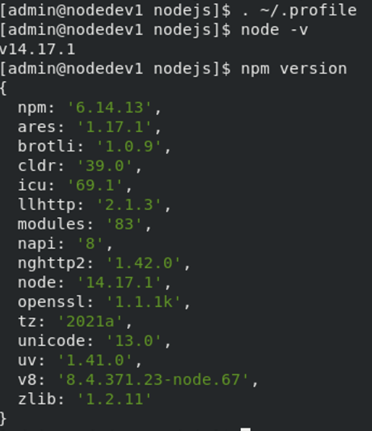
Run this command to refresh your profile:
. ~/.profile
To make sure everything was installed properly, run the following commands:
node –v
npm version
You must have node version 14.0.0 or greater for our tools to work properly
Notes:
Refer back often to download the latest IBM Security Template: https://security-design-guide.stage1.mybluemix.net/brand/essentials/marketing-assets/#

Slide 6
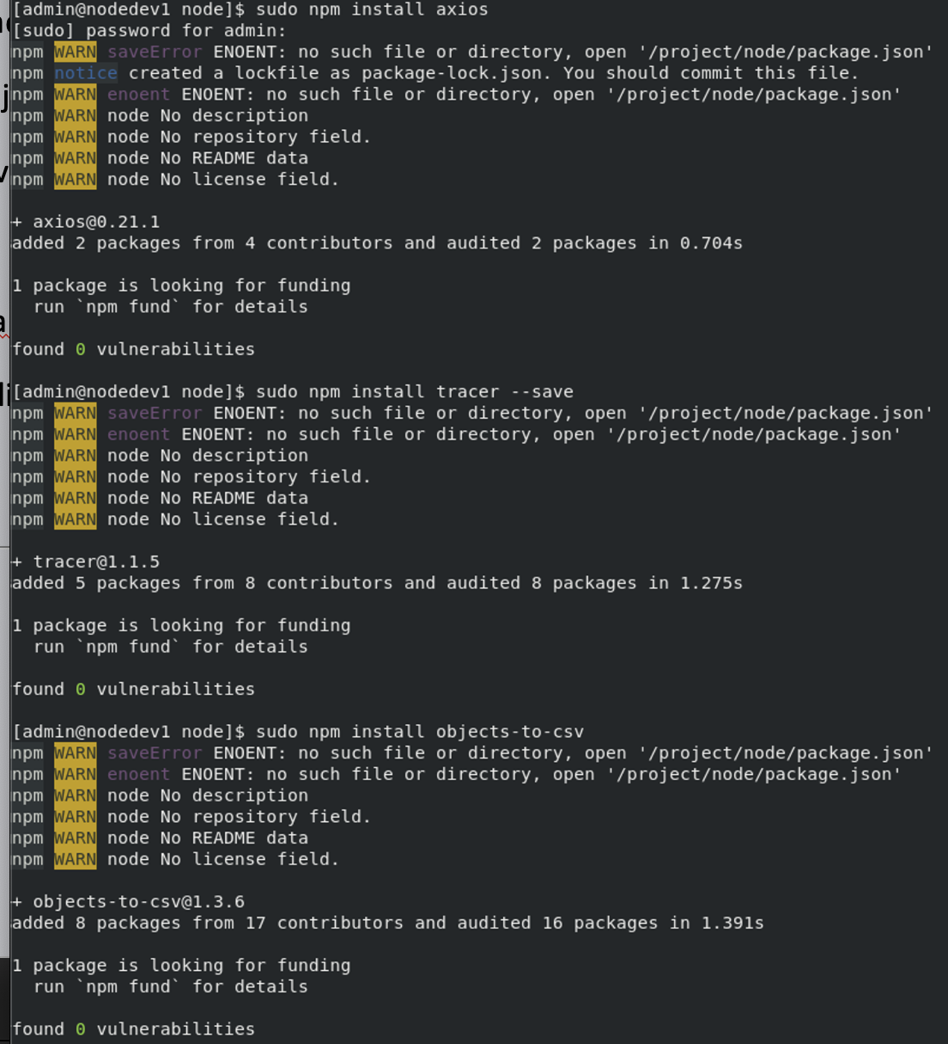
Navigate to the directory where you wish to install the source code
Run these commands:
sudo npm install axios
sudo npm install tracer --save
sudo npm install objects-to-csv
Notes:
Refer back often to download the latest IBM Security Template: https://security-design-guide.stage1.mybluemix.net/brand/essentials/marketing-assets/#

Slide 7
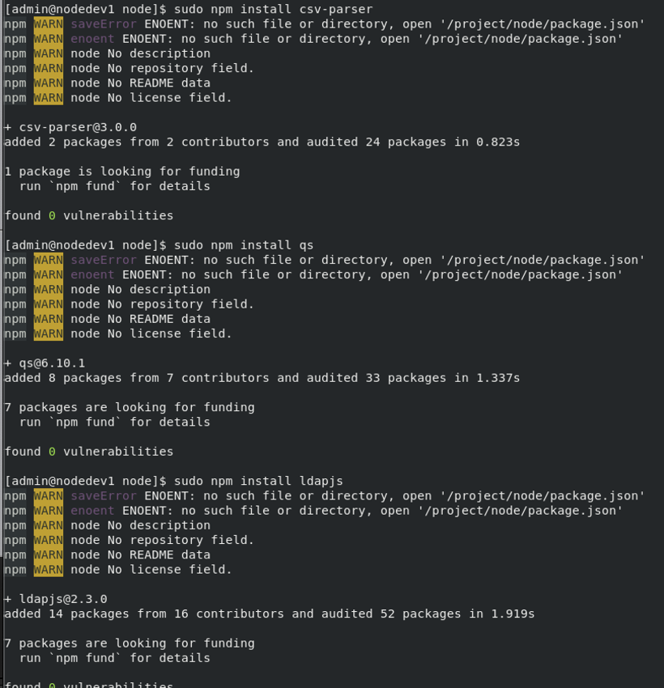
Run these commands:
sudo npm install csv-parser
sudo npm install qs
sudo npm install ldapjs
Notes:
Refer back often to download the latest IBM Security Template: https://security-design-guide.stage1.mybluemix.net/brand/essentials/marketing-assets/#

Slide 8
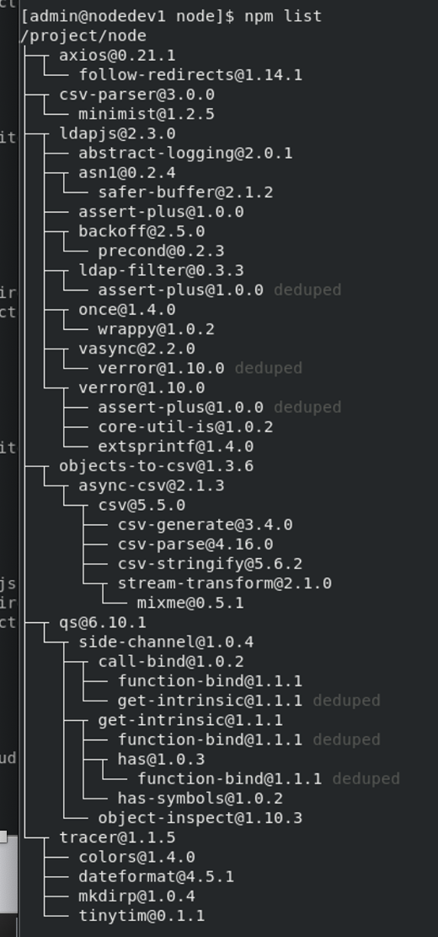
At the end run:
npm list
This will let you see all installed packages. It includes additional pre-requisite packages.
Notes:
Refer back often to download the latest IBM Security Template: https://security-design-guide.stage1.mybluemix.net/brand/essentials/marketing-assets/#

Slide 9
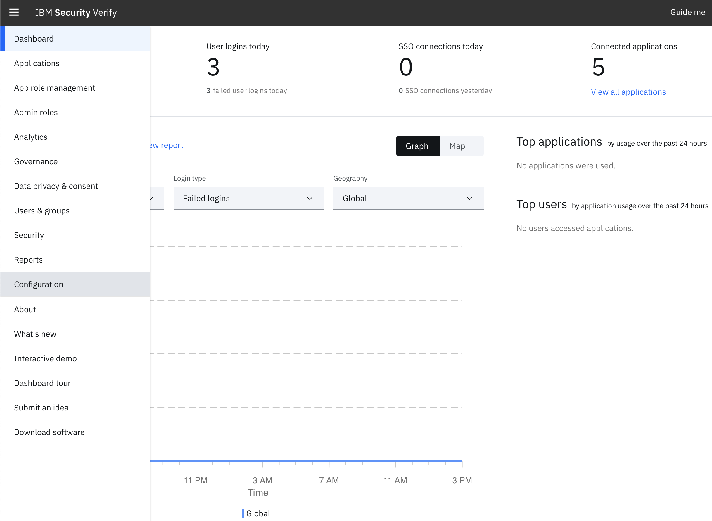
Now we will have to create a client id and client secret for our API. To do this, go to the admin view of your tenant and click the hamburger button on the top left and navigate to the “configuration page”
Notes:
Refer back often to download the latest IBM Security Template: https://security-design-guide.stage1.mybluemix.net/brand/essentials/marketing-assets/#

Slide 10
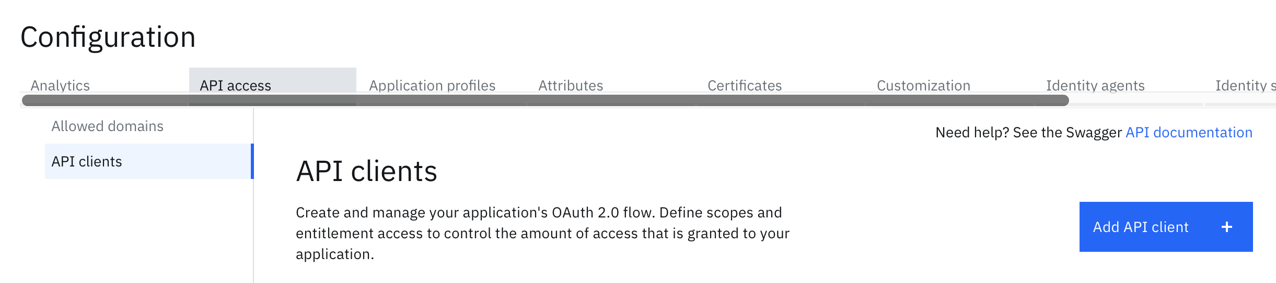
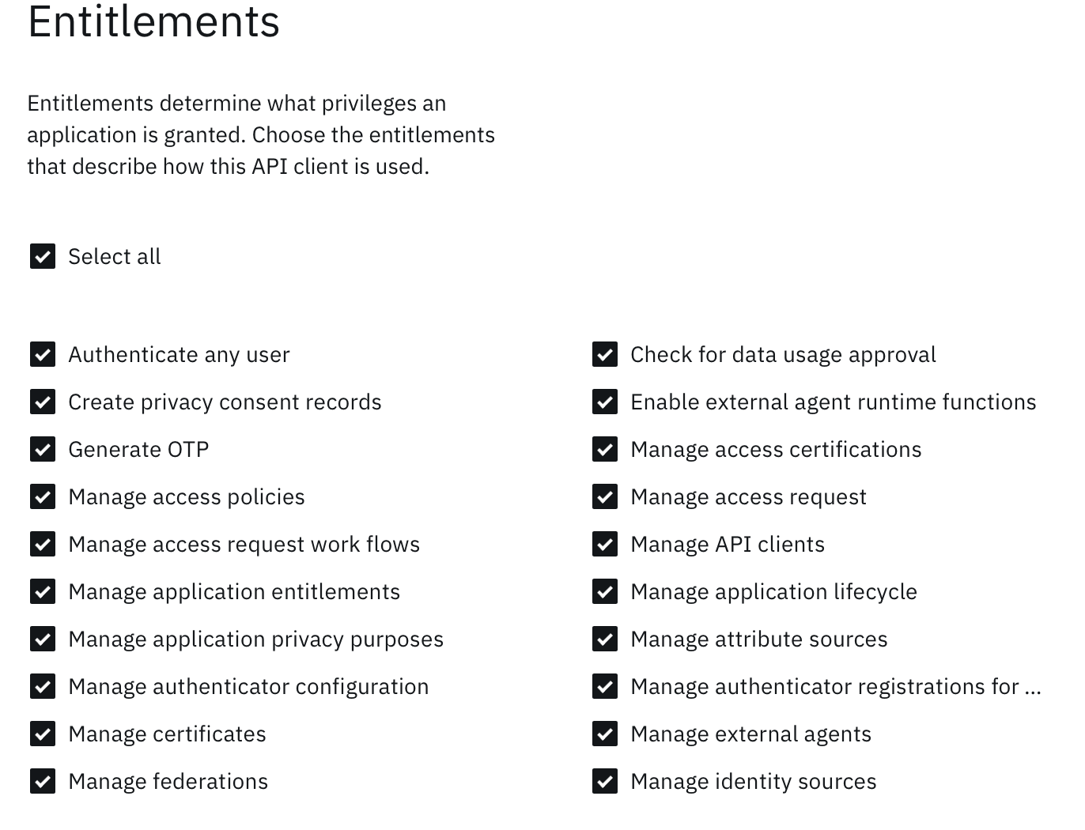
Click on “API access” then ”API clients” and click on the blue button to add a new API client
Select all entitlements and leave all the other settings as default until you get to the last page
Add bullet here explaining they can put in proper entitlements according to their needs
Notes:
Refer back often to download the latest IBM Security Template: https://security-design-guide.stage1.mybluemix.net/brand/essentials/marketing-assets/#

Slide 11
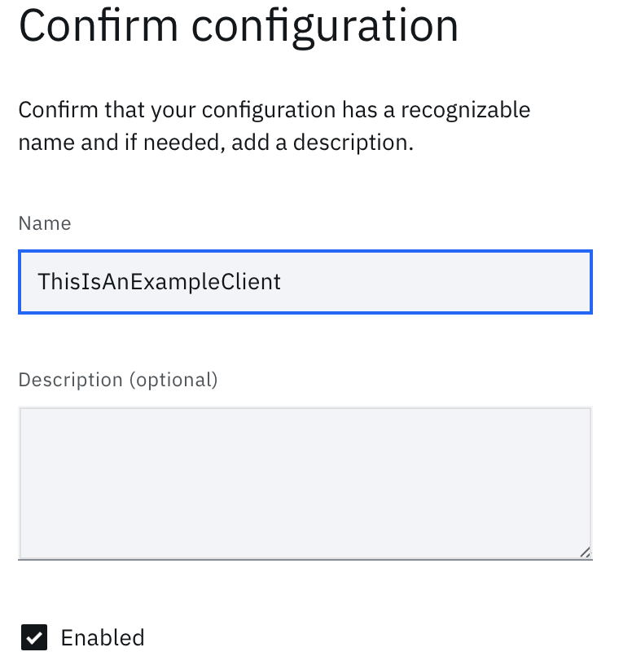
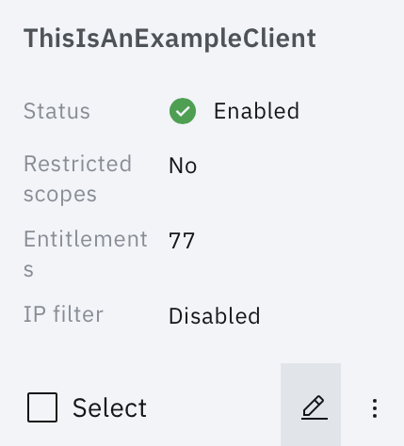
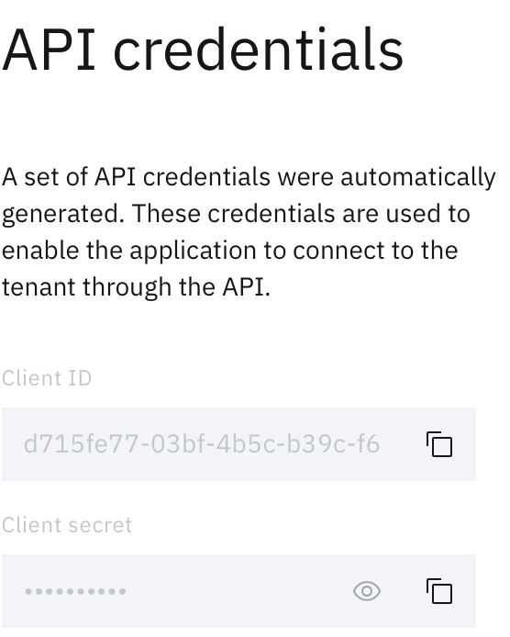
Give your client a name and then click “Create API client”
Click on the pencil to edit information about your client
Scroll down to the API credentials section, you will need the client ID and client secret for the next part
Notes:
Refer back often to download the latest IBM Security Template: https://security-design-guide.stage1.mybluemix.net/brand/essentials/marketing-assets/#

Slide 12
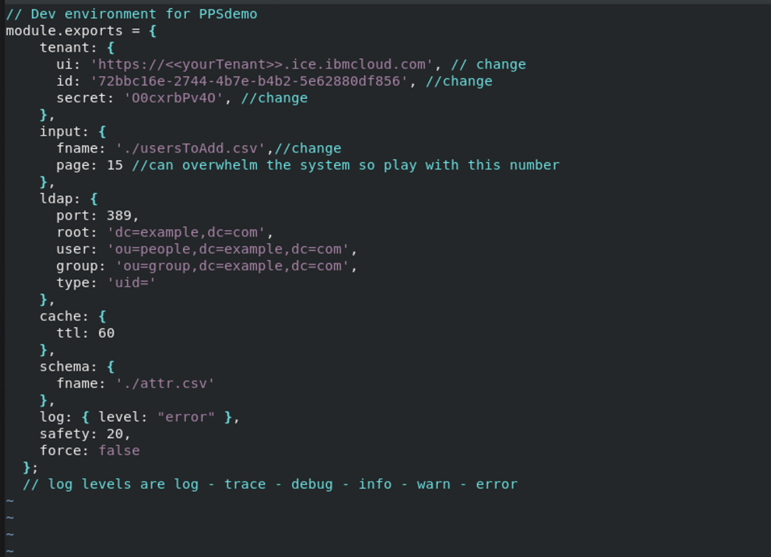
In the same directory you ran the “npm install commands”, create a document and call it “env.js”
At minimum, you need to populate the tenant section with the necessary information (ui, id, secret)
If you are going to add a large number of users, fill in the input field as well.
There are 5 log levels, set it to error for normal use cases, set it to debug if you run into issues and are trying to fix something, set to log if you want to see all information (including all other log levels)
**Note: if you want to import a large number of users, specify the .csv file path in the value for fname in input
Notes:
Refer back often to download the latest IBM Security Template: https://security-design-guide.stage1.mybluemix.net/brand/essentials/marketing-assets/#

Slide 13
You will receive a zip file containing the source code. Put it inside of the same directory we have been working in using the mv command (mv currentLocation destination). Run the following commands:
unzip src.zip
rm src.zip
After this, your directory should resemble the following:
You are now ready to start using our tools
Notes:
Refer back often to download the latest IBM Security Template: https://security-design-guide.stage1.mybluemix.net/brand/essentials/marketing-assets/#

Slide 14
After editing the necessary values in env.js, run the following command and you should get a similar output:
node src/test.js
Notes:
Refer back often to download the latest IBM Security Template: https://security-design-guide.stage1.mybluemix.net/brand/essentials/marketing-assets/#

Slide 15
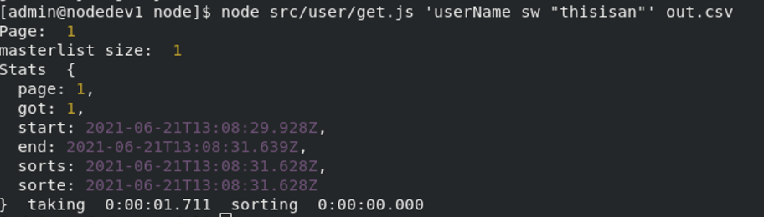
If you want to get certain users based off specifications and output them in a .csv file, you can call the following command:
node src/user/get.js ‘putWhateverFilterYouwantHere’ specifyNameOfOutputFile.csv
Some examples of filters you can use are on the following slide
If you navigate to the output file you specified and open it in a text editor, you should see all the users that match the filter as shown below.
Notes:
Refer back often to download the latest IBM Security Template: https://security-design-guide.stage1.mybluemix.net/brand/essentials/marketing-assets/#

Slide 16
Some examples of some common filters are
eq - this one is to check if two things are equal, e.g. username eq “bob” checks if the user’s username is bob
sw – this filter outputs everything that starts with what you specify, e.g. username sw “bob” would return all users whose username starts with Bob
ew – this filter outputs everything that ends with what you specify, e.g. username ew “ob” would return all users whose username ends with ob
If you don’t want to provide a filter, put ‘’ as a placeholder where the filter would go, e.g.
node src/user/get.js ‘’ out.csv
Notes:
Refer back often to download the latest IBM Security Template: https://security-design-guide.stage1.mybluemix.net/brand/essentials/marketing-assets/#

Slide 17
To add a large number of users, create a csv file and put users in the following format
Make sure the password has capital letters, numbers and special characters, and that you have specified this file in the value of fname of the env.js file
After you have created the csv file and specified it in env.js, run the following command:
node src/user/post.js
Note that the format is the same as user/get.js so we can pull users from one environment to another
If the user already exists, a new one will not be created and the existing one will not be modified
Notes:
Refer back often to download the latest IBM Security Template: https://security-design-guide.stage1.mybluemix.net/brand/essentials/marketing-assets/#

Slide 18
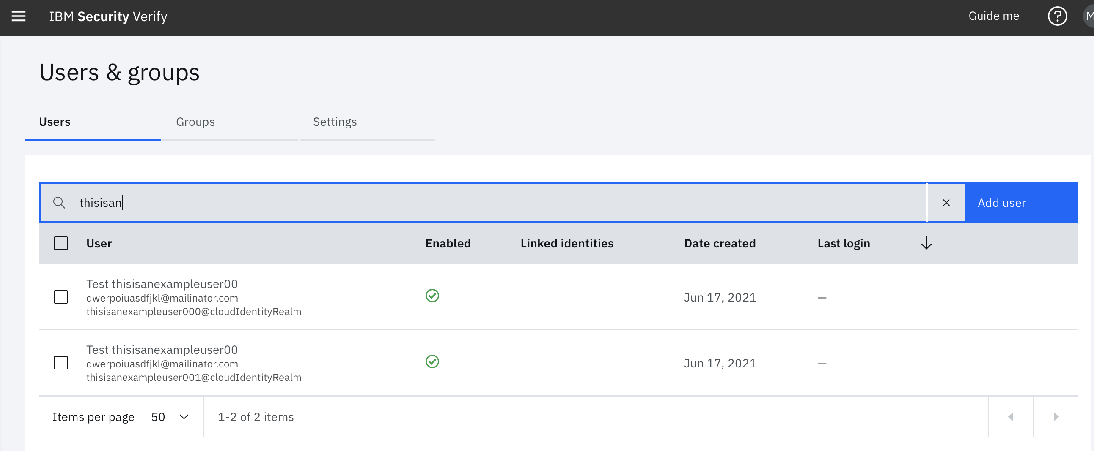
Now all users that were inputted into the .csv file will be viewable on the tenant specified in env.js
Notes:
Refer back often to download the latest IBM Security Template: https://security-design-guide.stage1.mybluemix.net/brand/essentials/marketing-assets/#

Slide 19
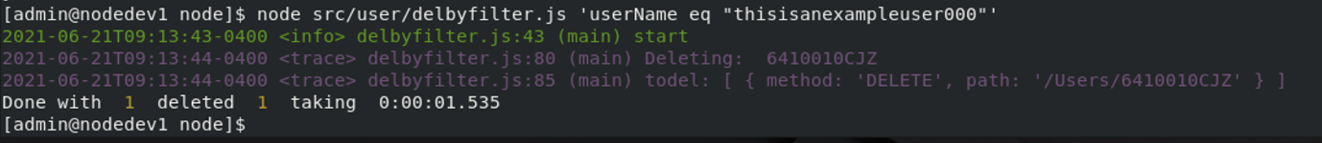
If you want to delete a user(s), you can call the following command:
node src/user/delbyfilter.js ‘insertDesiredFilterHere’
You will never be able to delete more than 500 users at a time, if you need to delete more than 20 users, modify the safety and force flag in the env.js file and then run this command
The usable filters are the same as the ones for the get.js command
Notes:
Refer back often to download the latest IBM Security Template: https://security-design-guide.stage1.mybluemix.net/brand/essentials/marketing-assets/#

Slide 20
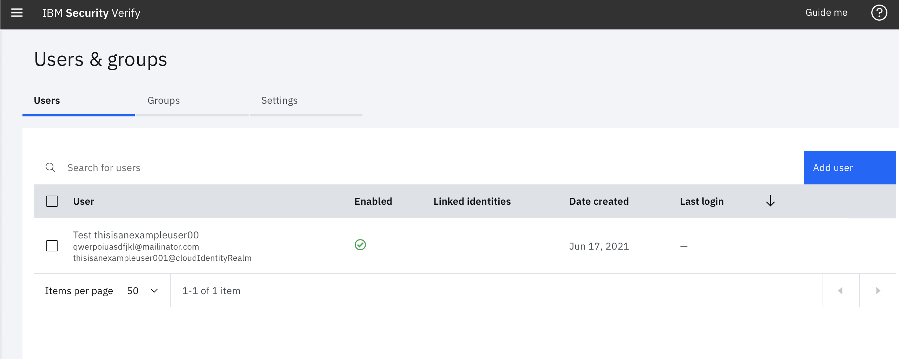
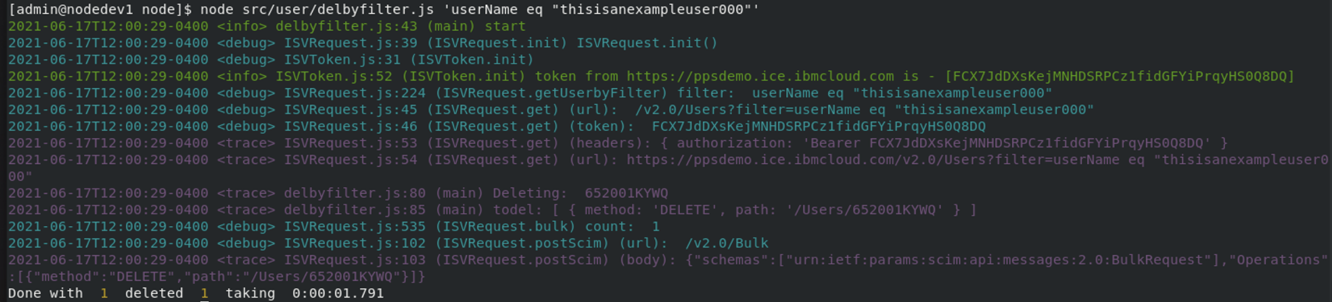
The user has successfully been deleted
Notes:
Refer back often to download the latest IBM Security Template: https://security-design-guide.stage1.mybluemix.net/brand/essentials/marketing-assets/#

Slide 21
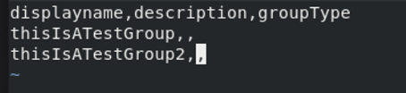
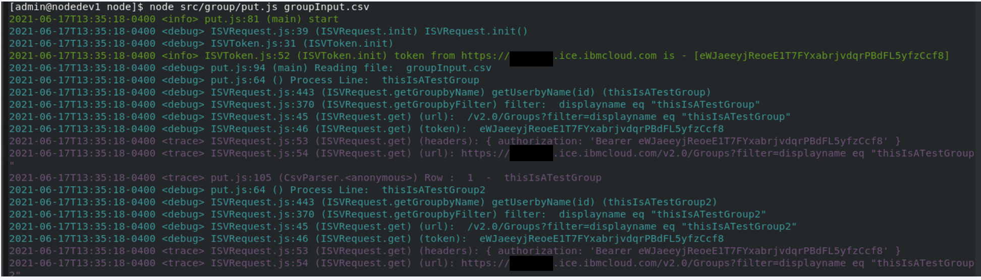
To create groups from a csv file, make sure file is in the following format:
Then run the following command:
node src/group/put.js specifyPathToInputFile.csv
Notes:
Refer back often to download the latest IBM Security Template: https://security-design-guide.stage1.mybluemix.net/brand/essentials/marketing-assets/#

Slide 22
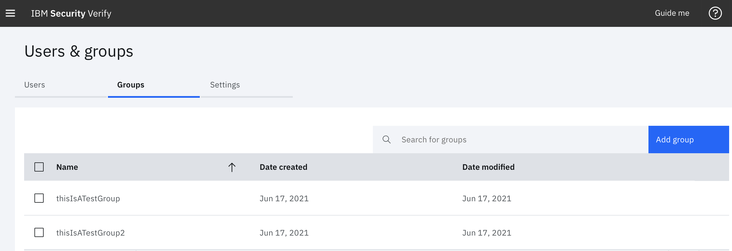
The groups that were specified in the .csv file are now viewable in the tenant
Notes:
Refer back often to download the latest IBM Security Template: https://security-design-guide.stage1.mybluemix.net/brand/essentials/marketing-assets/#

Slide 23
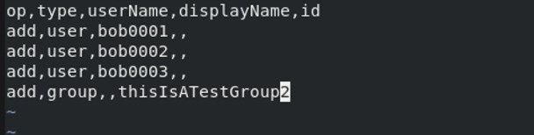
To make changes to an existing group by reading a .csv file, make sure the csv file is formatted in the following way:
There are 3 ways to do this:
node src/group/patchmem.js ‘dir/test.csv’ ‘grp00’ will read operations from test.csv and perform them on grp 00 and upload the changes to the tenant
Notes:
Refer back often to download the latest IBM Security Template: https://security-design-guide.stage1.mybluemix.net/brand/essentials/marketing-assets/#

Slide 24
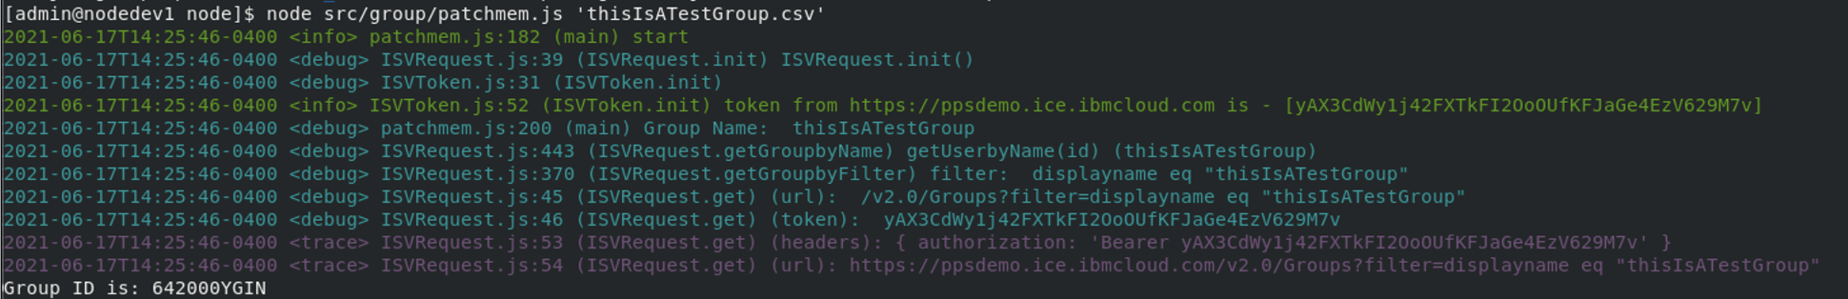
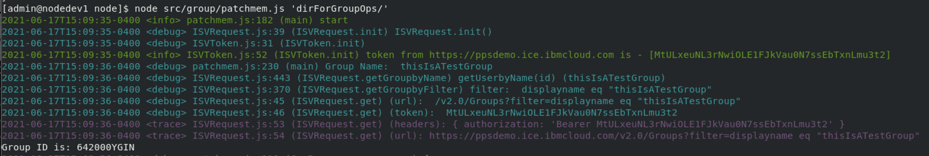
node src/group/patchmem.js ‘dir/test.csv’ looks in test.csv and performs operations on the ‘test’ group and uploads the changes to the tenant
node src/group/patchmem.js ‘dir’ reads all .csv files in dir and patches the operations to the group that matches the prefix to the file extension (put a / after dir name to avoid running into issues)
Notes:
Refer back often to download the latest IBM Security Template: https://security-design-guide.stage1.mybluemix.net/brand/essentials/marketing-assets/#

Slide 25
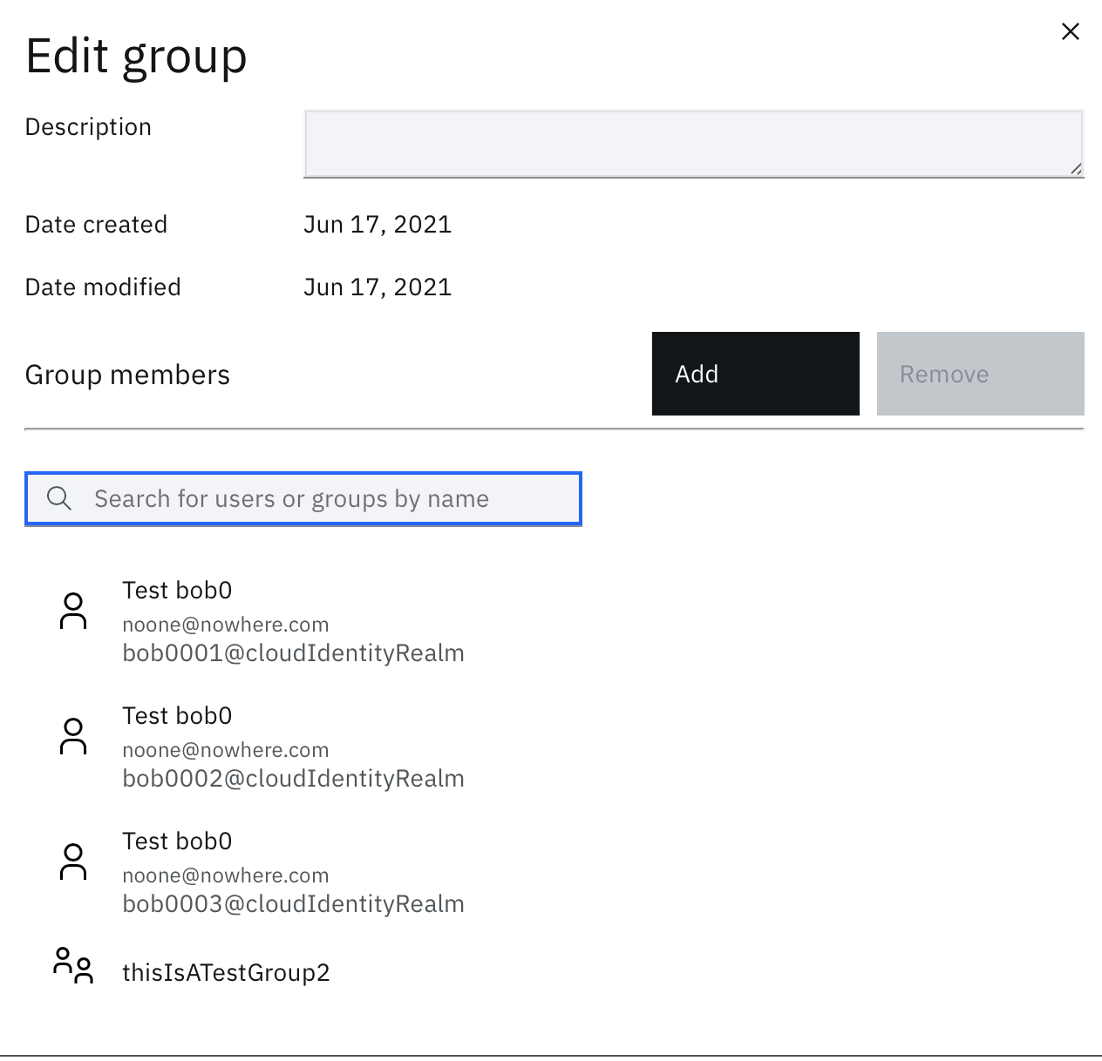
The changes are now viewable inside the tenant to the group(s) you have made the change to
Notes:
Refer back often to download the latest IBM Security Template: https://security-design-guide.stage1.mybluemix.net/brand/essentials/marketing-assets/#

Slide 26
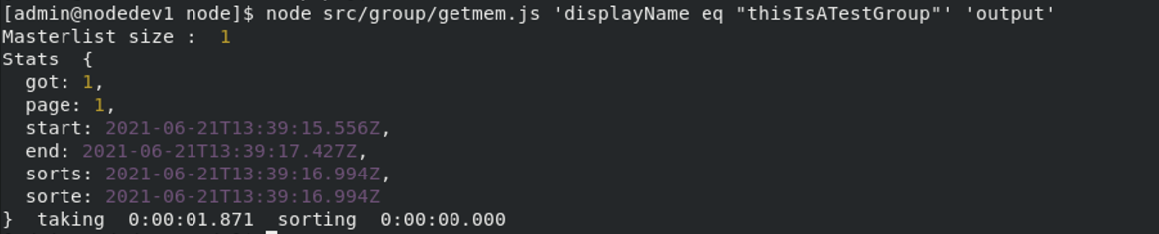
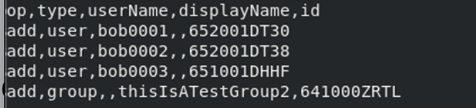
To get all the members of a group outputted into a .csv file run the following command:
node src/group/getmem.js ‘insertfilterhere’ ‘insert output file name’
The output file will resemble this but with the information from the group that was inputted
Notes:
Refer back often to download the latest IBM Security Template: https://security-design-guide.stage1.mybluemix.net/brand/essentials/marketing-assets/#

Slide 27
Questions?

